Slide 1
Understanding the crystal shape in the growth of nanostructures
Rajrupa Paul, Jehyeok Ryu, Hoda Shirzad & Elias Stutz
Seminar presentation for MSE-649 Crystal growth by epitaxy
August 28th, 2020

Slide 2
Motivation : Why understanding the crystal faceting is crucial?
shapes control can improve optical, electrical, and catalytic properties in case of metallic nanoparticles
the control of morphology and crystalline quality allows for the optimization of devices for a large variety of semiconductor structures
crystal faceting and morphology-dependent properties are also interesting for organic compounds used in molecular recognition and in medical applications

Slide 3
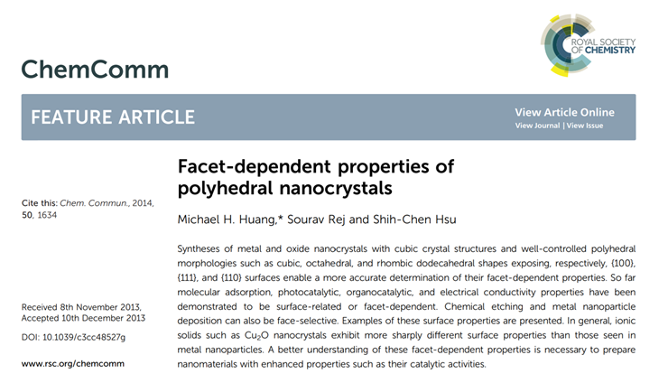
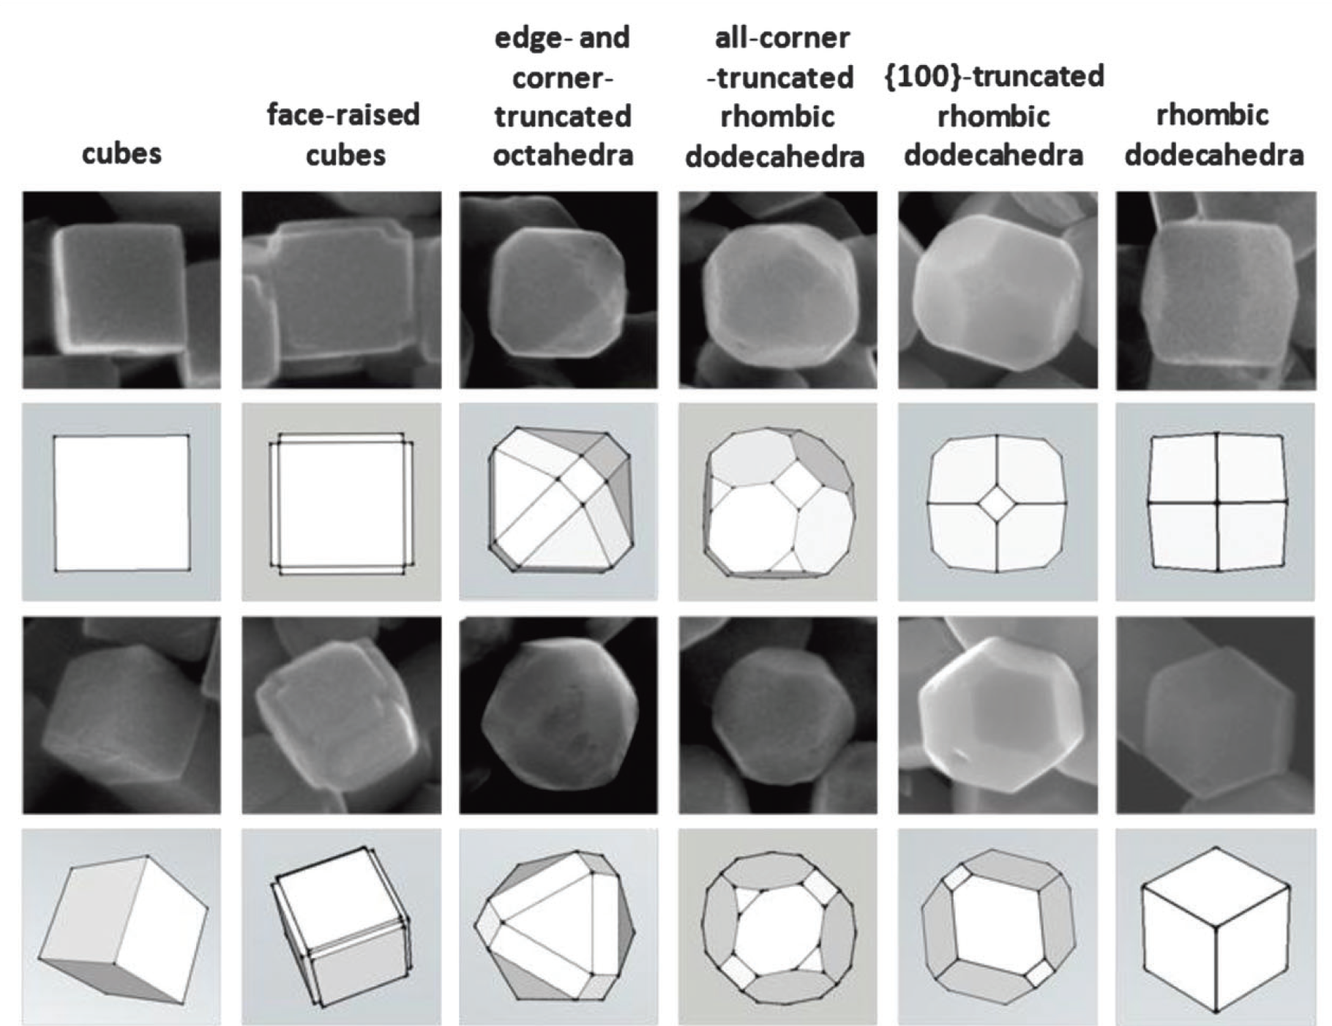
Facet-dependent Properties

Slide 4
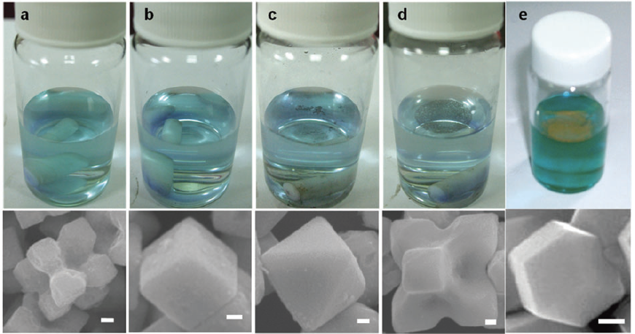
Facet dependent properties
Interactions of charged molecules with metal oxide crystals exposing different surface facets.
Photographs of methylene blue solutions taken after dispersing Ag2O (a) octapods, (b) cubes, (c) octahedra, and (d) hexapods with stirring for 60 min. (e) Photograph of a methylene blue solution mixed with rhombic dodecahedral Cu2O nanocrystals and stirred for 30 min. SEM images of the respective particles are shown below the photographs. Scale bars are all equal to 100 nm. Remarkably, Ag2O octahedra and hexapods and Cu2O rhombic dodecahedra have floated to the top of the solution due to repulsive electrostatic interactions between the positively charged methylene blue molecules and the positively charged {111} and {110} faces of Ag2O and Cu2O crystals.

Slide 5
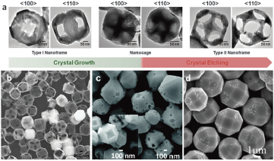
Facet dependent properties
Face-selective etching and deposition processes on the surfaces of nanocrystals
a) SEM image showing the formation of two types of Cu2O nanoframes with empty {100} faces (type I) and {110} faces (type II) and nanocages resulting from crystal growth and face-selective etching processes. (b) SEM image of hollow Cu2O cubes with empty {110} edges. (c) SEM image of edge-truncated octahedral Ag2O crystals after the controlled etching by NH3 to yield etched {100} corners and {110} edges. The inset shows rhombicu-boctahedral Ag2O crystals with etched square {100} faces. (d) SEM image of rhombicuboctahedral Cu2O microcrystals with Cu nanoparticles selectively deposited on the {111} faces.

Slide 6
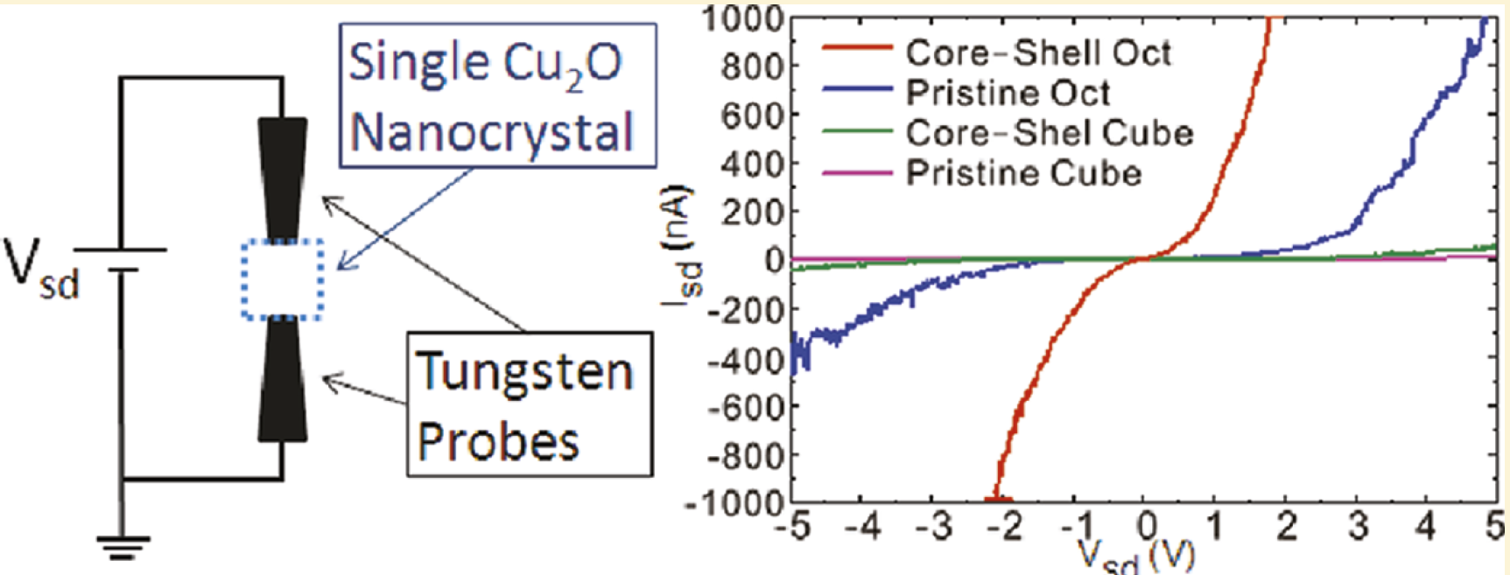

Facet dependent properties
Facet-dependent electrical conductivity of Cu2O nanocrystals
. Am. Chem. Soc. 2011, 133, 4, 1052–1057

Slide 7
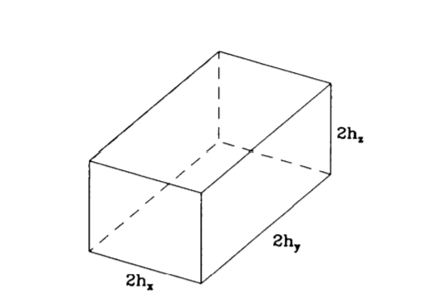




ECS: equilibrium crystal shape
Wulff’s Theorem : for a crystal at equilibrium, there exists a point in the interior such that its perpendicular distance hi from the ith face is proportional to γi: (γ1/h1) = (γ2/h2) = ...
Total surface energy
Minimizing the energy:

Slide 8
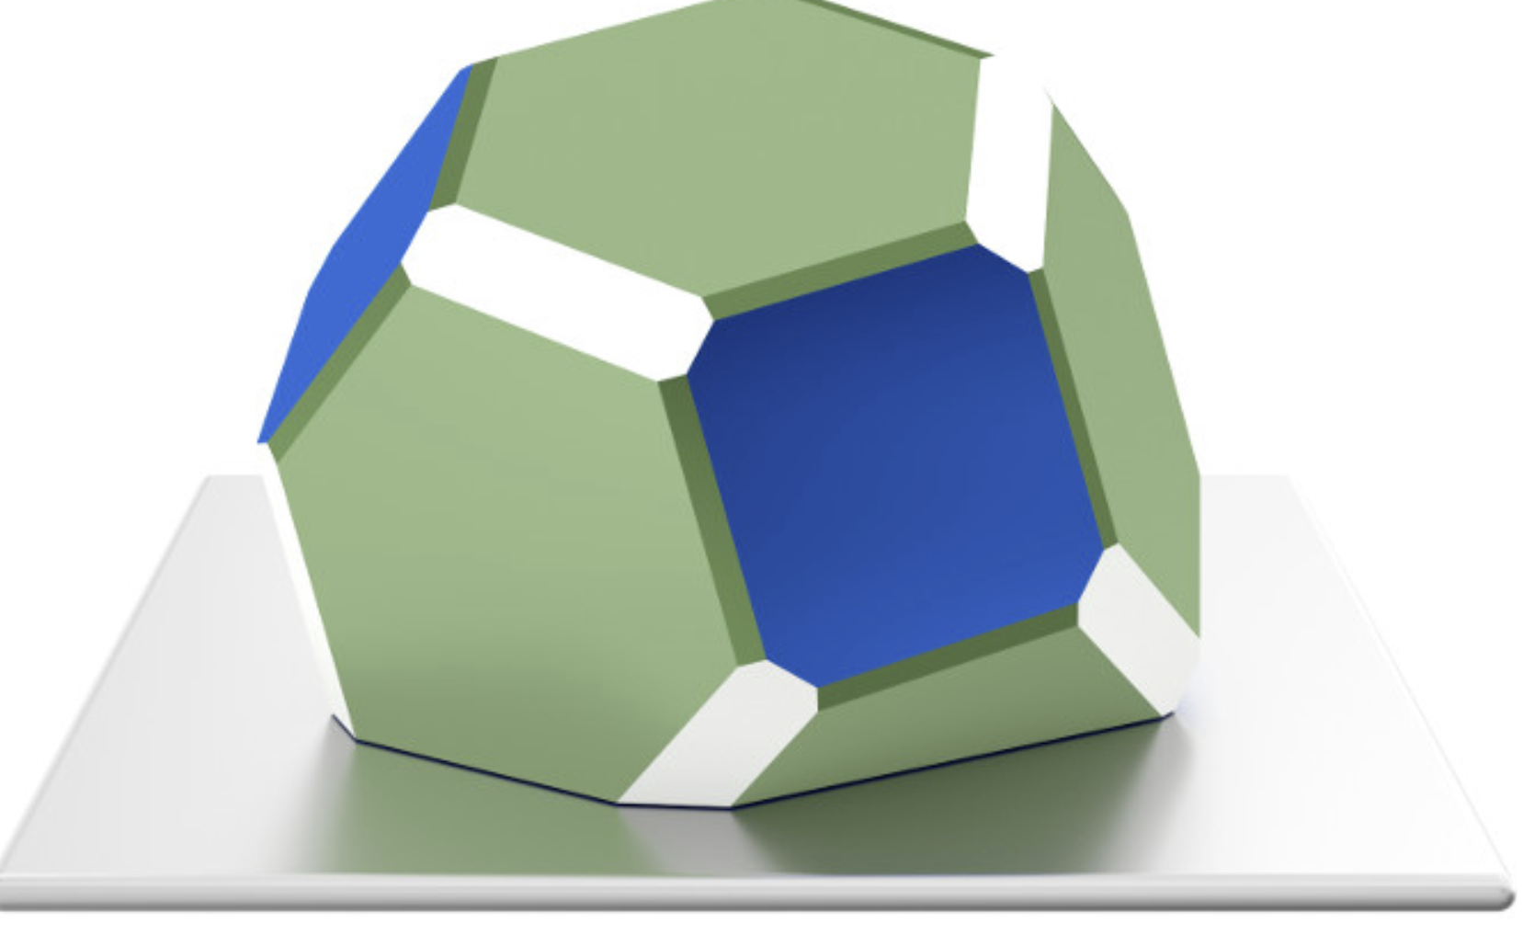
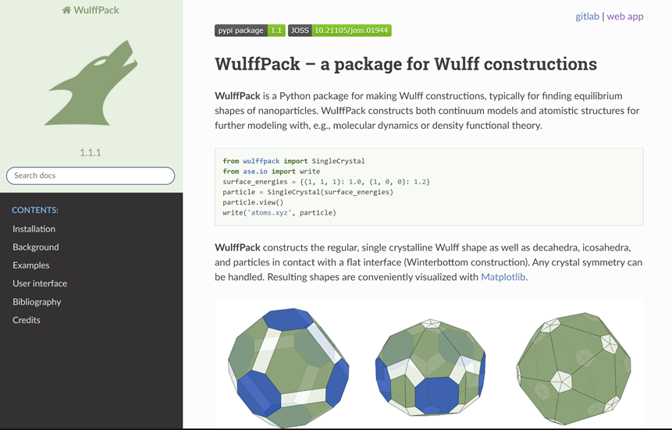
ECS: equilibrium crystal shape
Wulff and Winterbottom Construction
minimizing the total surface energy when the crystals place on solid substrates.

Slide 9
Modelling crystal shapes

Slide 10
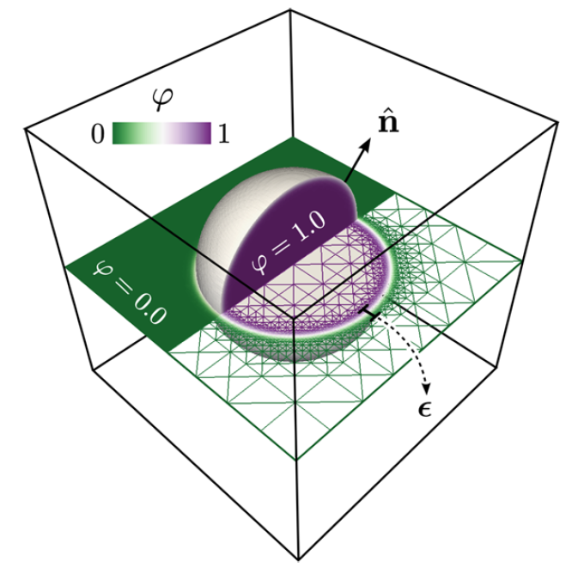

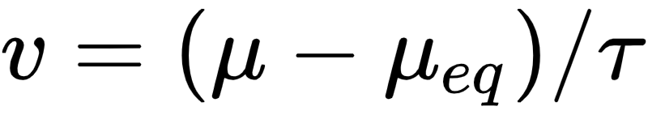
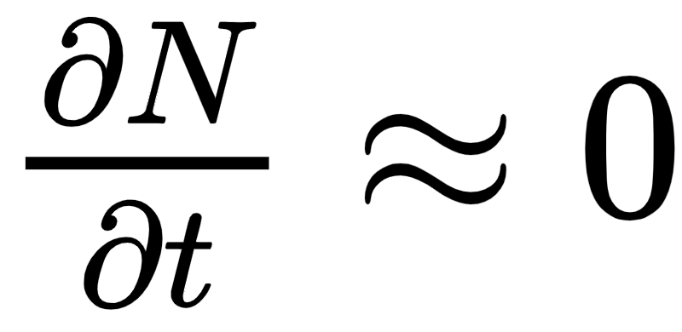


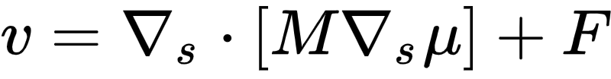
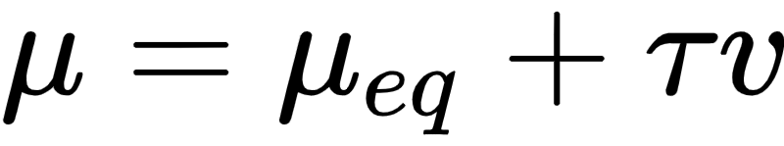
Description of the model
Cryst. Growth Des., 2787 (2015)
is neglected
Describe all equations, variables and parameters with respect to the ϕ field.
Solve evolution with a finite element method.
Notes:
The diffusion of adatoms follows the gradient of chemical potential along the surface

Slide 11
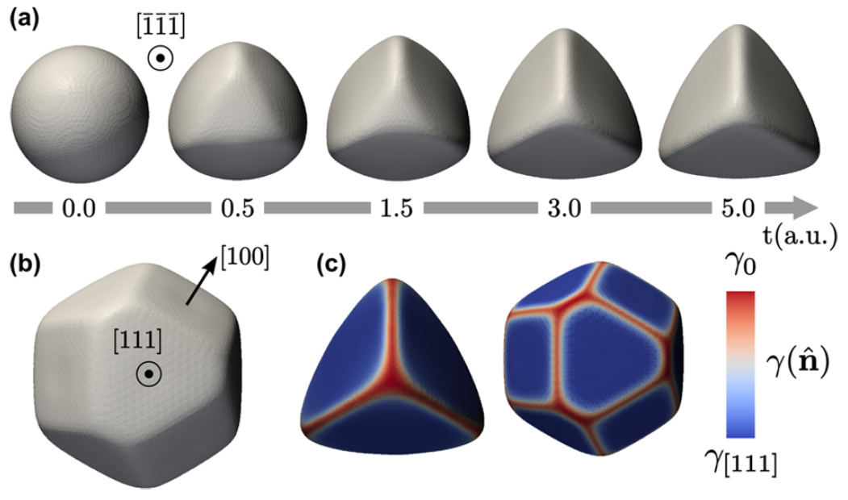
Showcasing the Phase-Field model: ECS
Surface energy minimal in the directions of the 4 vertices of a tetrahedron
Cryst. Growth Des., 2787 (2015)
Notes:
Self similarity

Slide 12
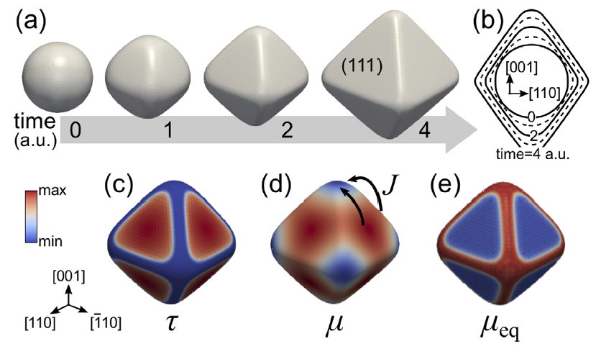
Showcasing the Phase-Field model: KCS
Adatom lifetime maximized on {111} facets
PSSB, 1800518 (2019)

Slide 13
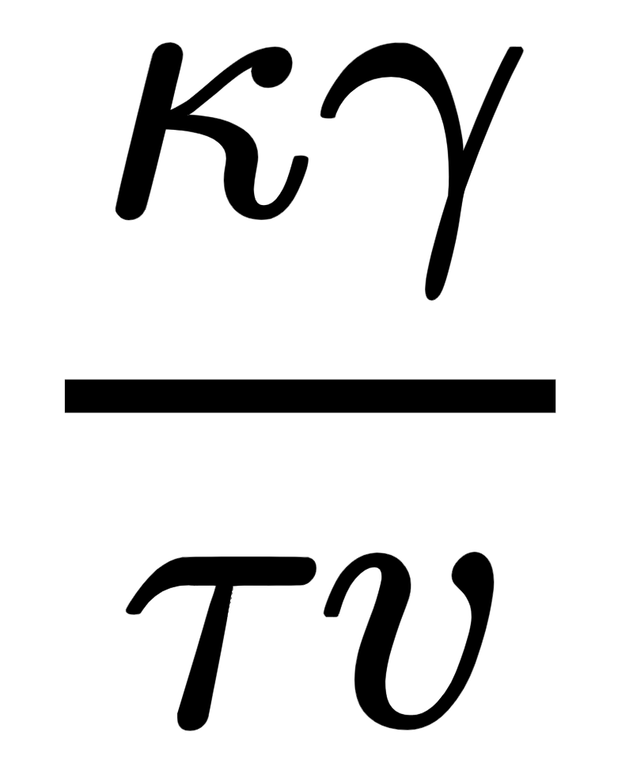
Thermodynamics VS kinetics
Equilibrium Crystal Shape
Kinetic Crystal Shape
Surface diffusion VS deposition dynamics
Surface energy VS adatom incorporation rates
Balance between the kinetics and energetic contributions

Slide 14
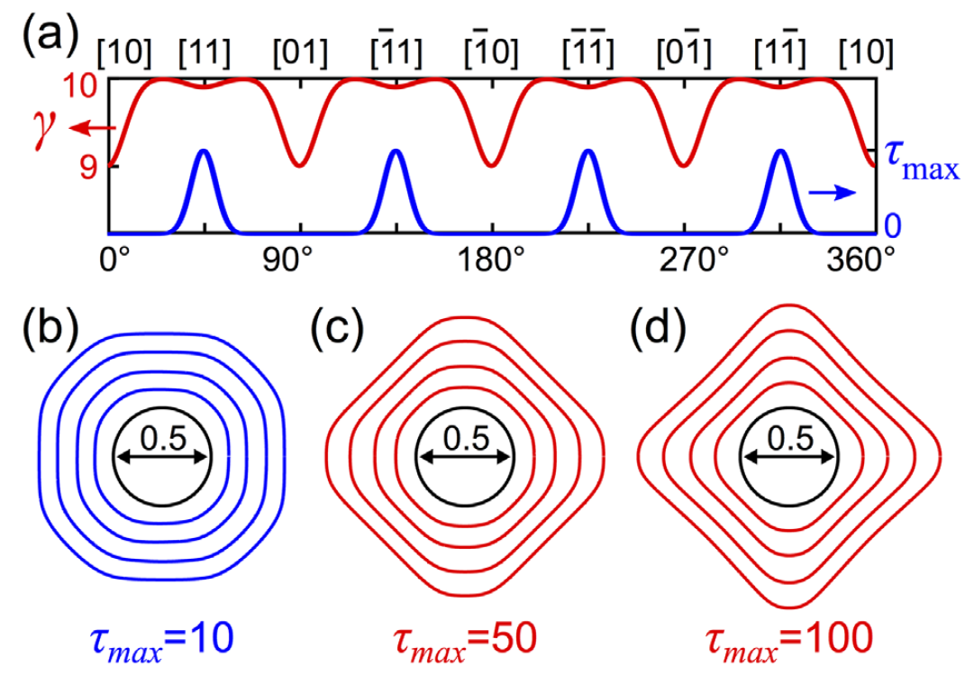
Interactions between γ and τ
γ favors {10} facets
τ favors {11} facets
interrupting
growth
Tends towards ECS
Tends towards KCS
PSSB, 1800518 (2019)

Slide 15
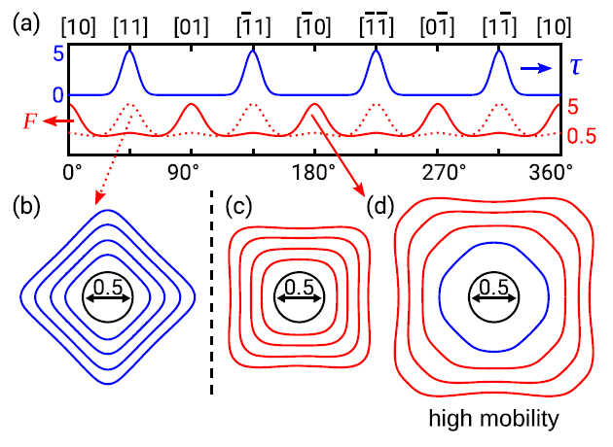
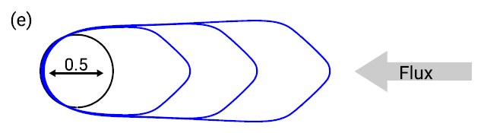
Interactions between τ and F
An increased magnitude of both factors drives growth towards the kinetic regime
Faceting from τ (n) dominates for small particles
The balance between different contributions is local
Thermodynamically controlled
Kinetically controlled
PSSB, 1800518 (2019)
Notes:
Faceting from τ (n) dominates foronly when:
F/M is low
Size does not exceed diffusion length
More important for small particles

Slide 16
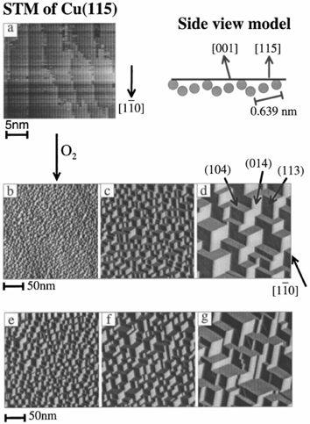

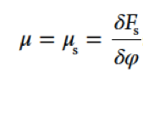


Strong Anisotropy
Ginzburg-Landau energy functional
Chemical Potential
Surface Science 454–456 (2000) 94–100

Slide 17

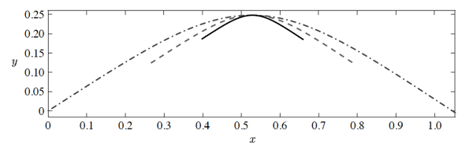

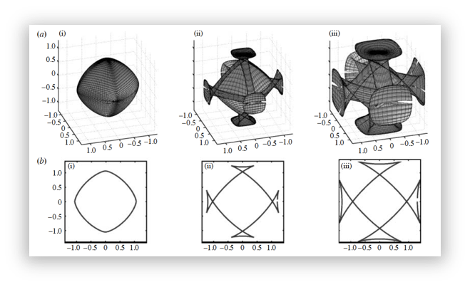




Modelling Strongly Anisotropic Systems
= 0.06
= 0.2
= 0.3
Proc. R. Soc. A (2009)

Slide 18
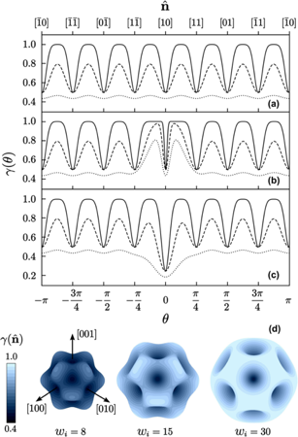
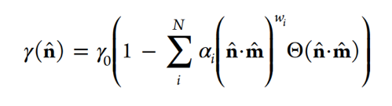
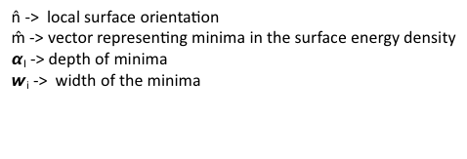


Surface Energy Density
Here:
Cryst. Growth Des., 2787 (2015)

Slide 19
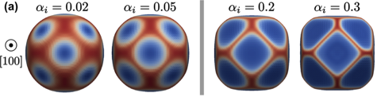
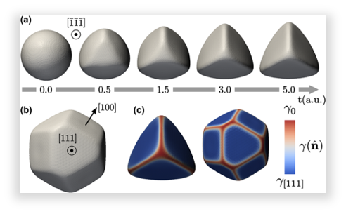
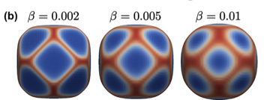
Evolution from Sphere toward the ECS
Cryst. Growth Des., 2787 (2015)

Slide 20
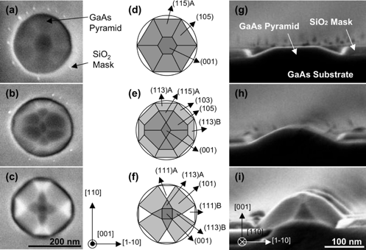
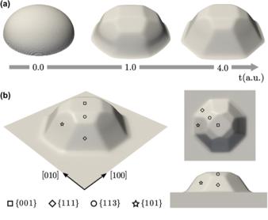
Morphologies of Metastable Structures
Cryst. Growth Des. 2010, 10, 2509
Cryst. Growth Des., 2787 (2015)

Slide 21
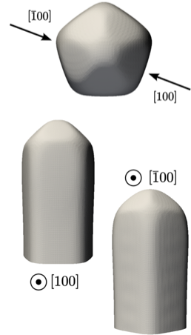
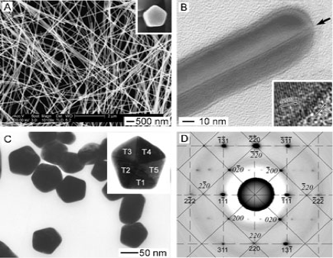
Morphologies of Metastable Structures
Chem. Eur. J. 2005, 11, 454 – 463
Cryst. Growth Des., 2787 (2015)

Slide 22
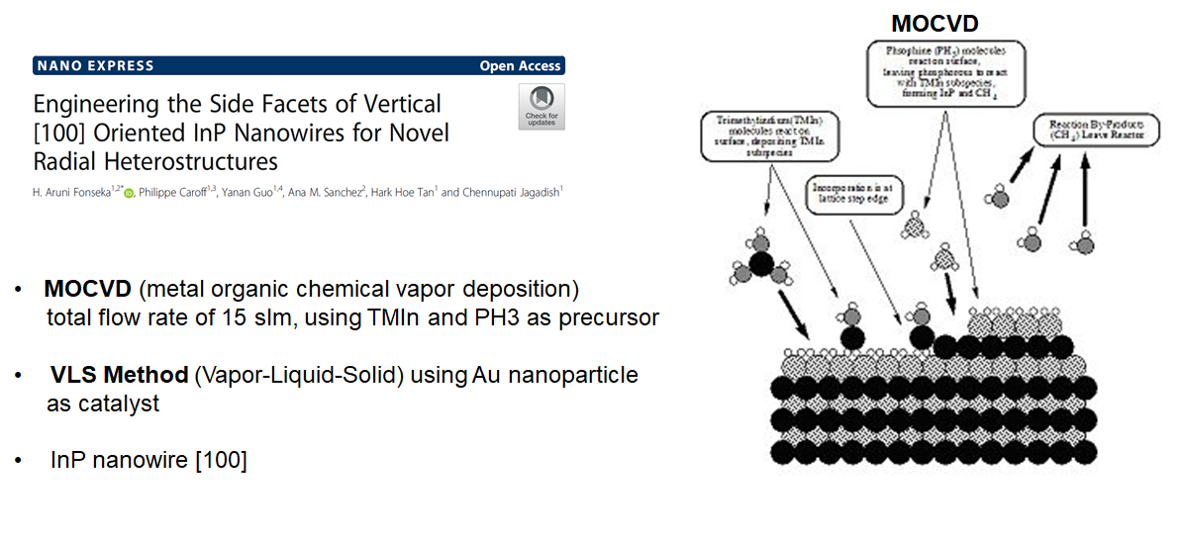
Introduction

Slide 23
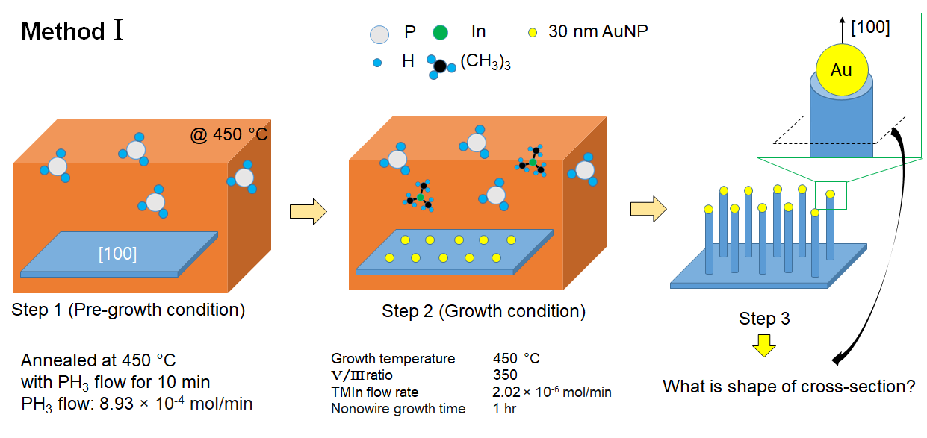

Slide 24
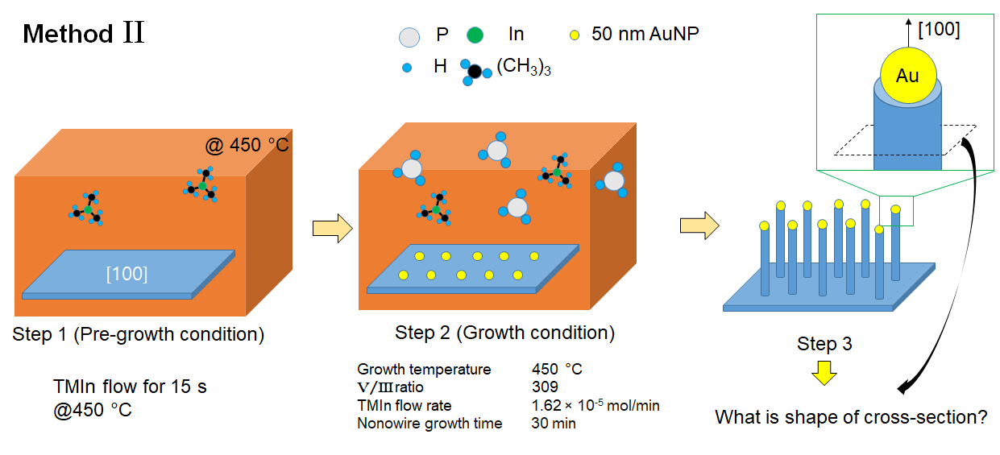

Slide 25
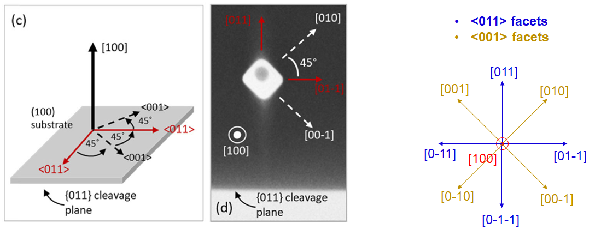
Possible two index facet combination

Slide 26
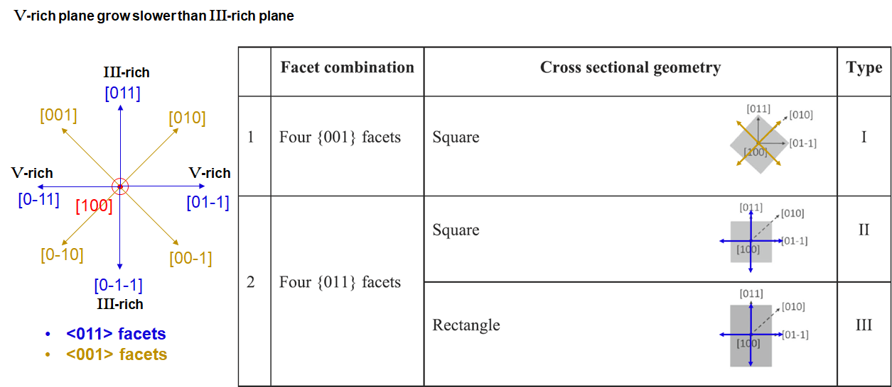
Possible two index facet combination

Slide 27
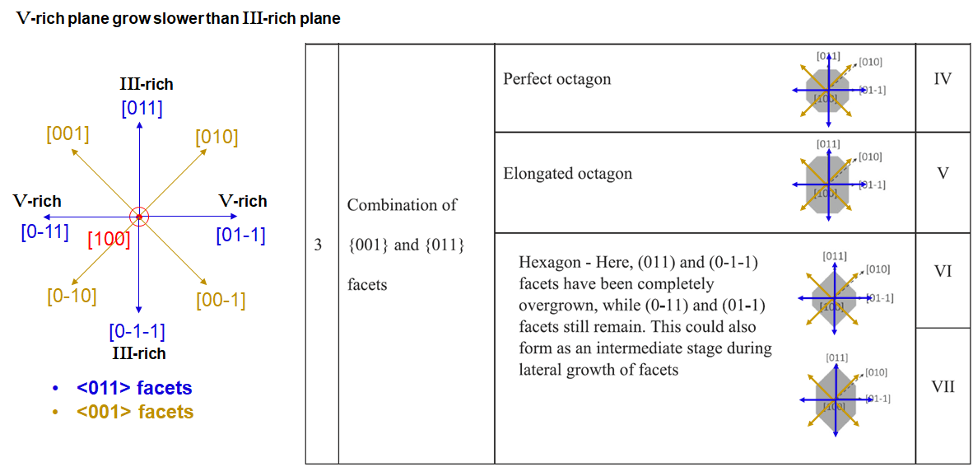
Possible two index facet combination

Slide 28
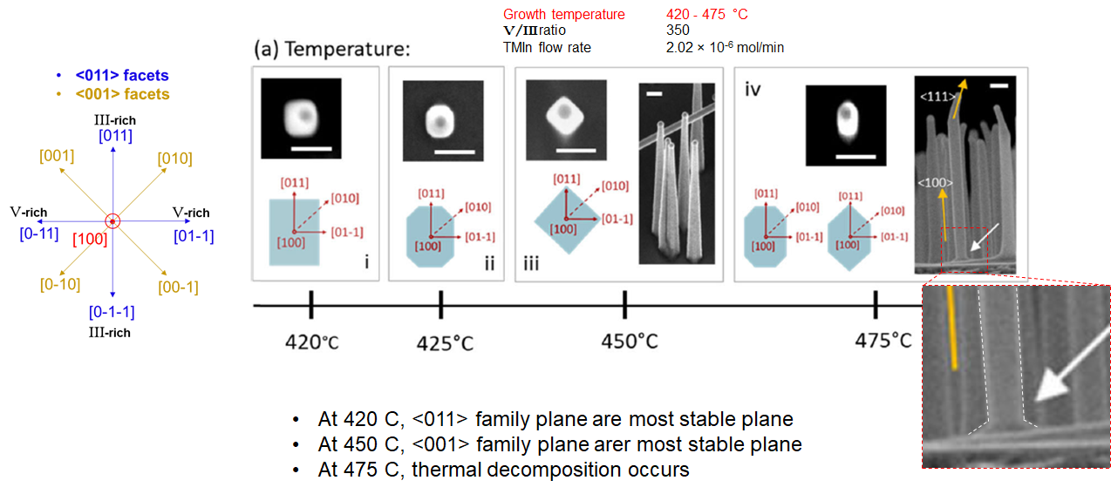
Side-facets with various Temperature (Method I)

Slide 29
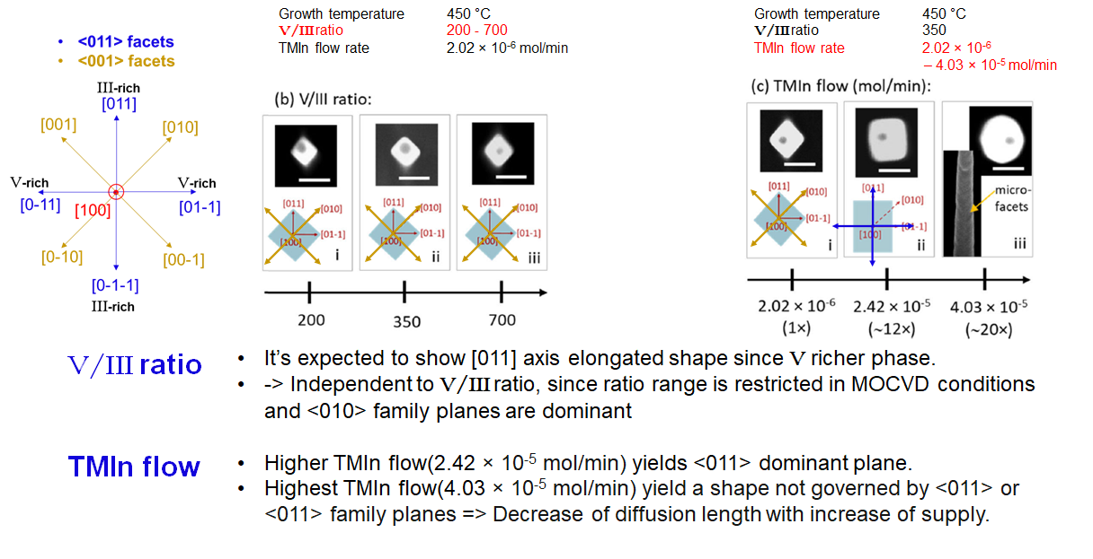
Side-facets with varying other parameter (Method I)

Slide 30
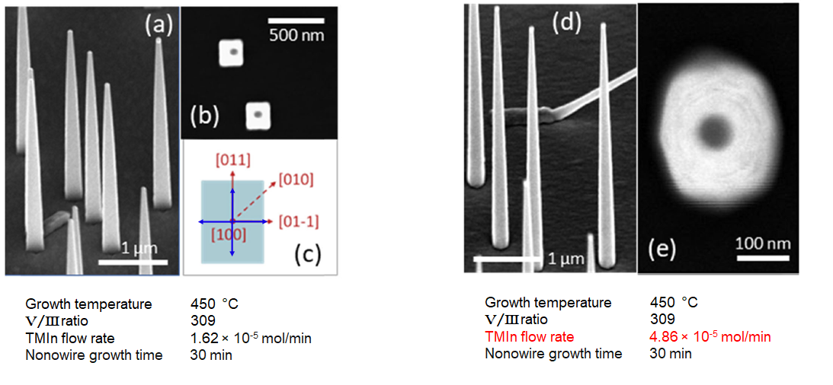
Side-facets with other pre-growth method (Method II)

Slide 31
Summary
Facet-Dependent properties
ECS: Wulff and Winterbottom construction
The relative magnitude of κ, γ, τ and v controls the growth regime (κγ/τv), which may change over time
Understanding strong anisotropy
Understanding metastable nanostructures with phase field model
MOCVD and VLS based side-facet engineering: Temperature, Growth rate.
Other affecting parameter: Thermal decomposition, Reduced diffusion length

Slide 32
Thank you for your attention

